Slide 1
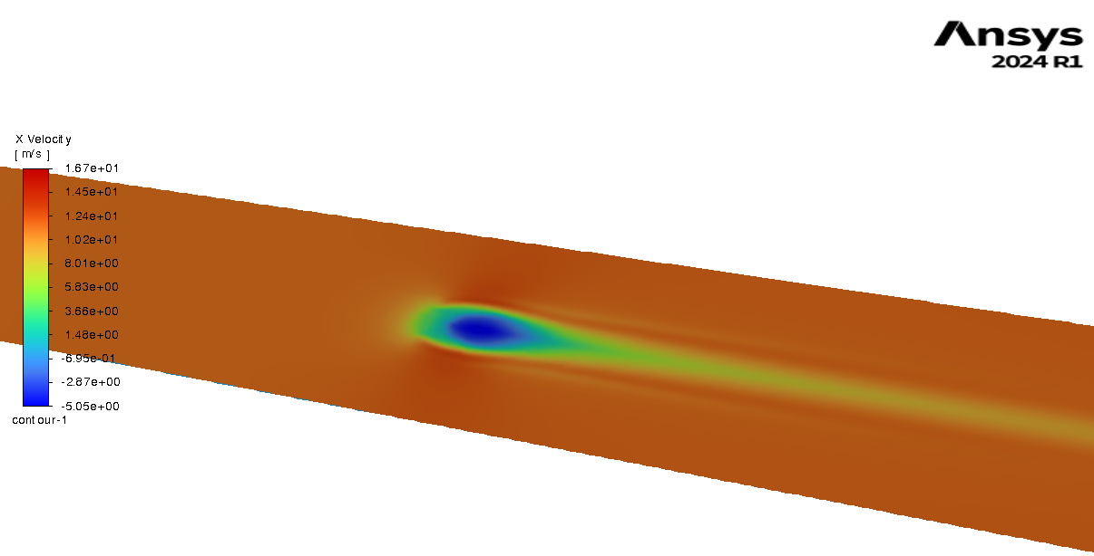
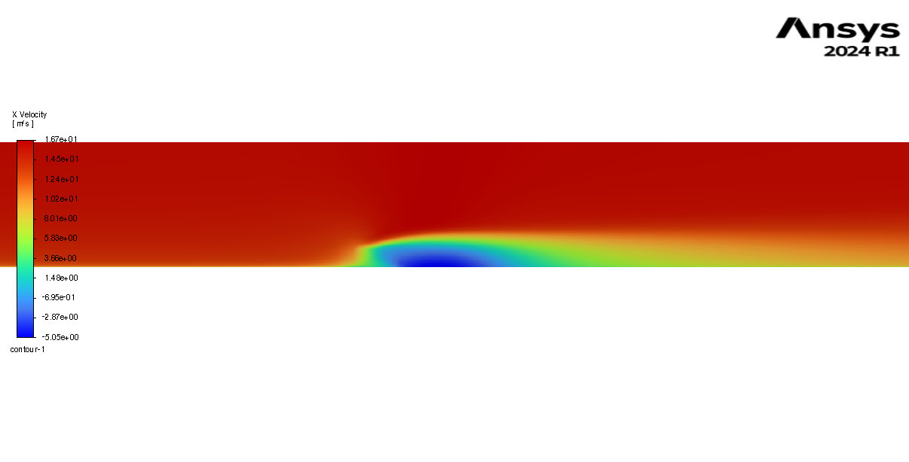
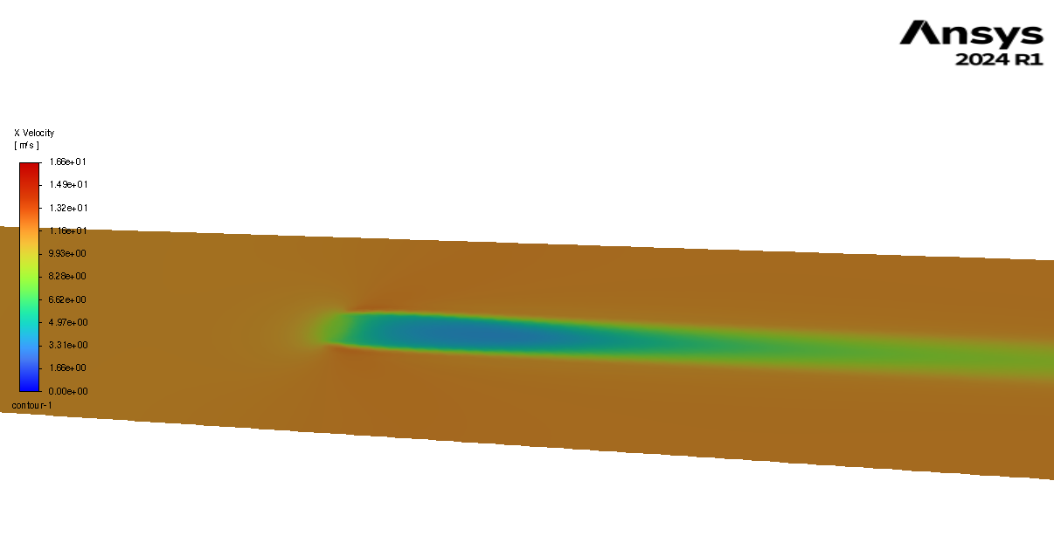
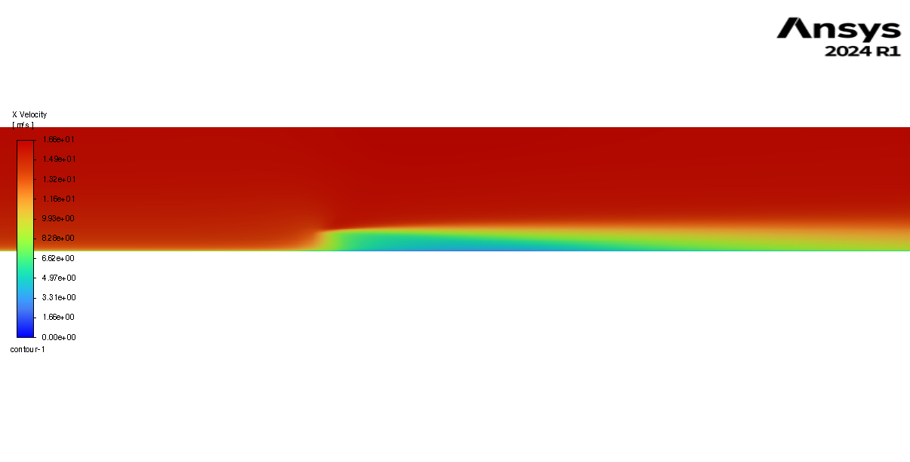
Height: 1.2m, width = 3m, u*=0.5m/s, p = 0.2
Height: 1.2m, width = 3m, u*=0.5m/s, p = 0.5

Slide 2
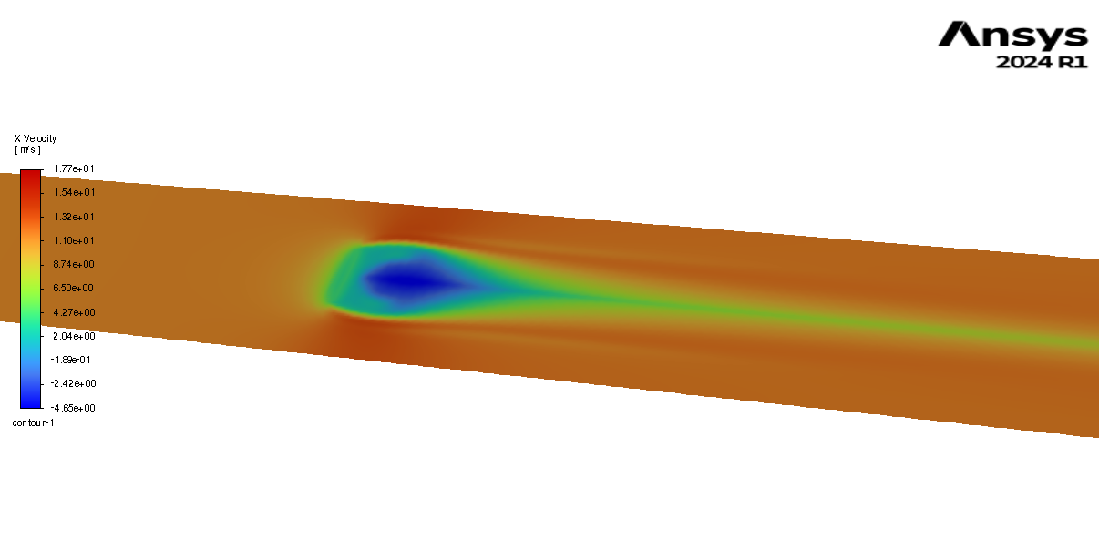
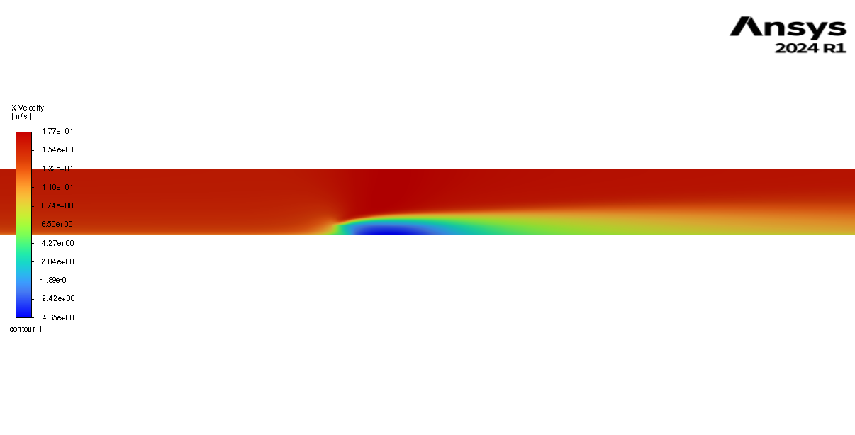
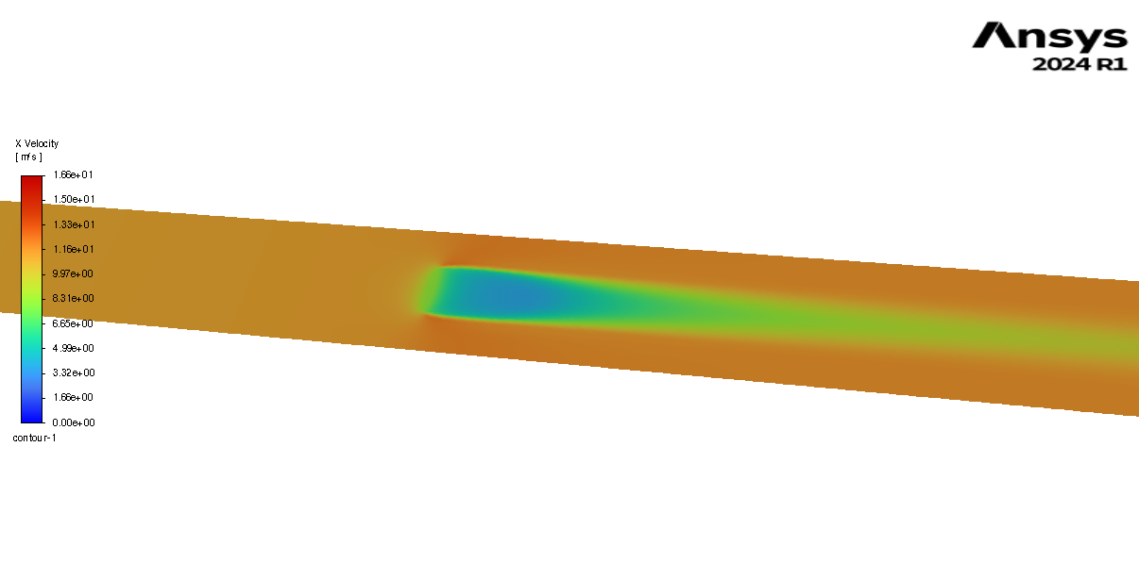
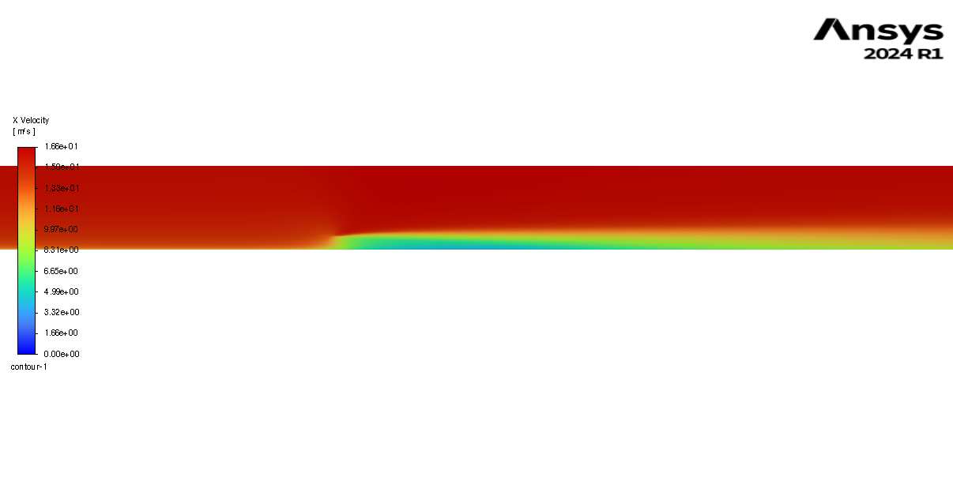
Height: 1.2m, width = 7.6m, u*=0.5m/s, p = 0.2
Height: 1.2m, width = 7.6m, u*=0.5m/s, p = 0.5

Slide 3
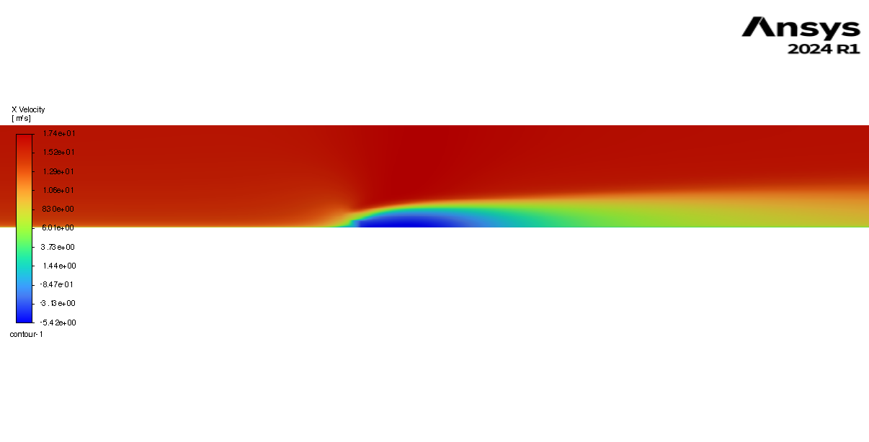
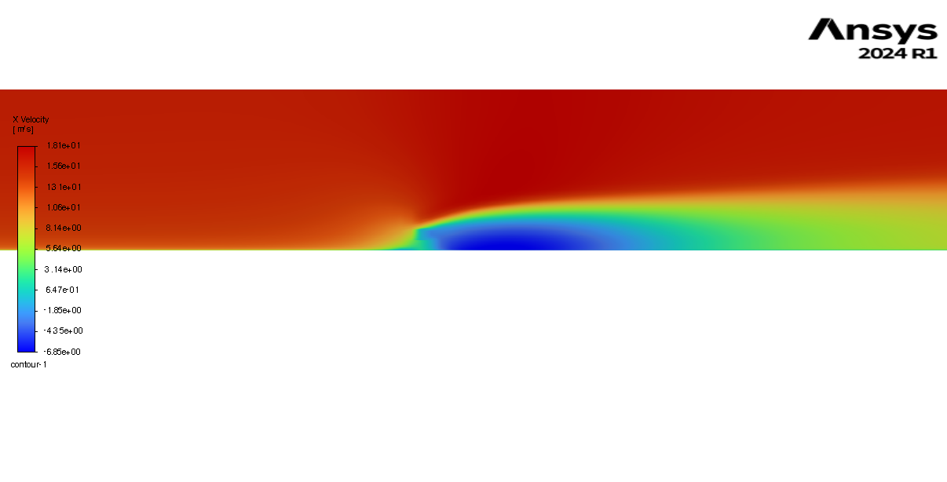
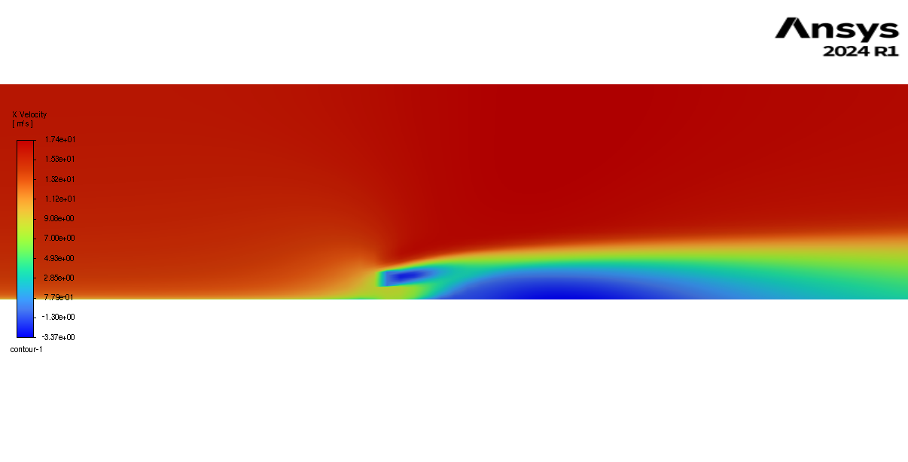
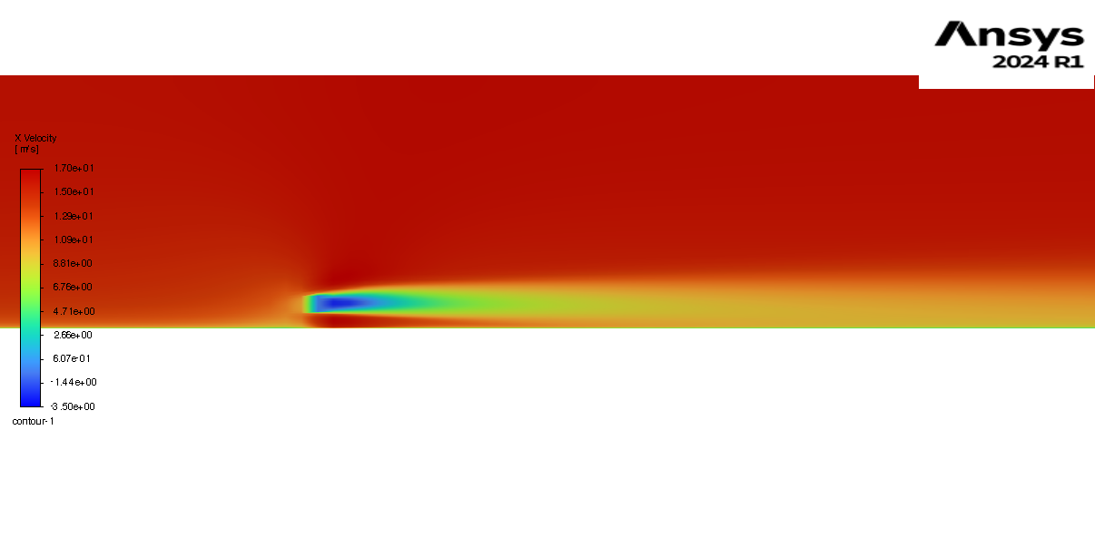
Height = 1m, width = 10m, top = 0.4p, bottom = 0p
Height = 1m, width = 10m, top = 0p, bottom = 0.1p
Height = 1m, width = 10m, top = 0p, bottom = 1 p
Height = 1m, width = 10m, top = 0p, bottom = 0.4p

Slide 4
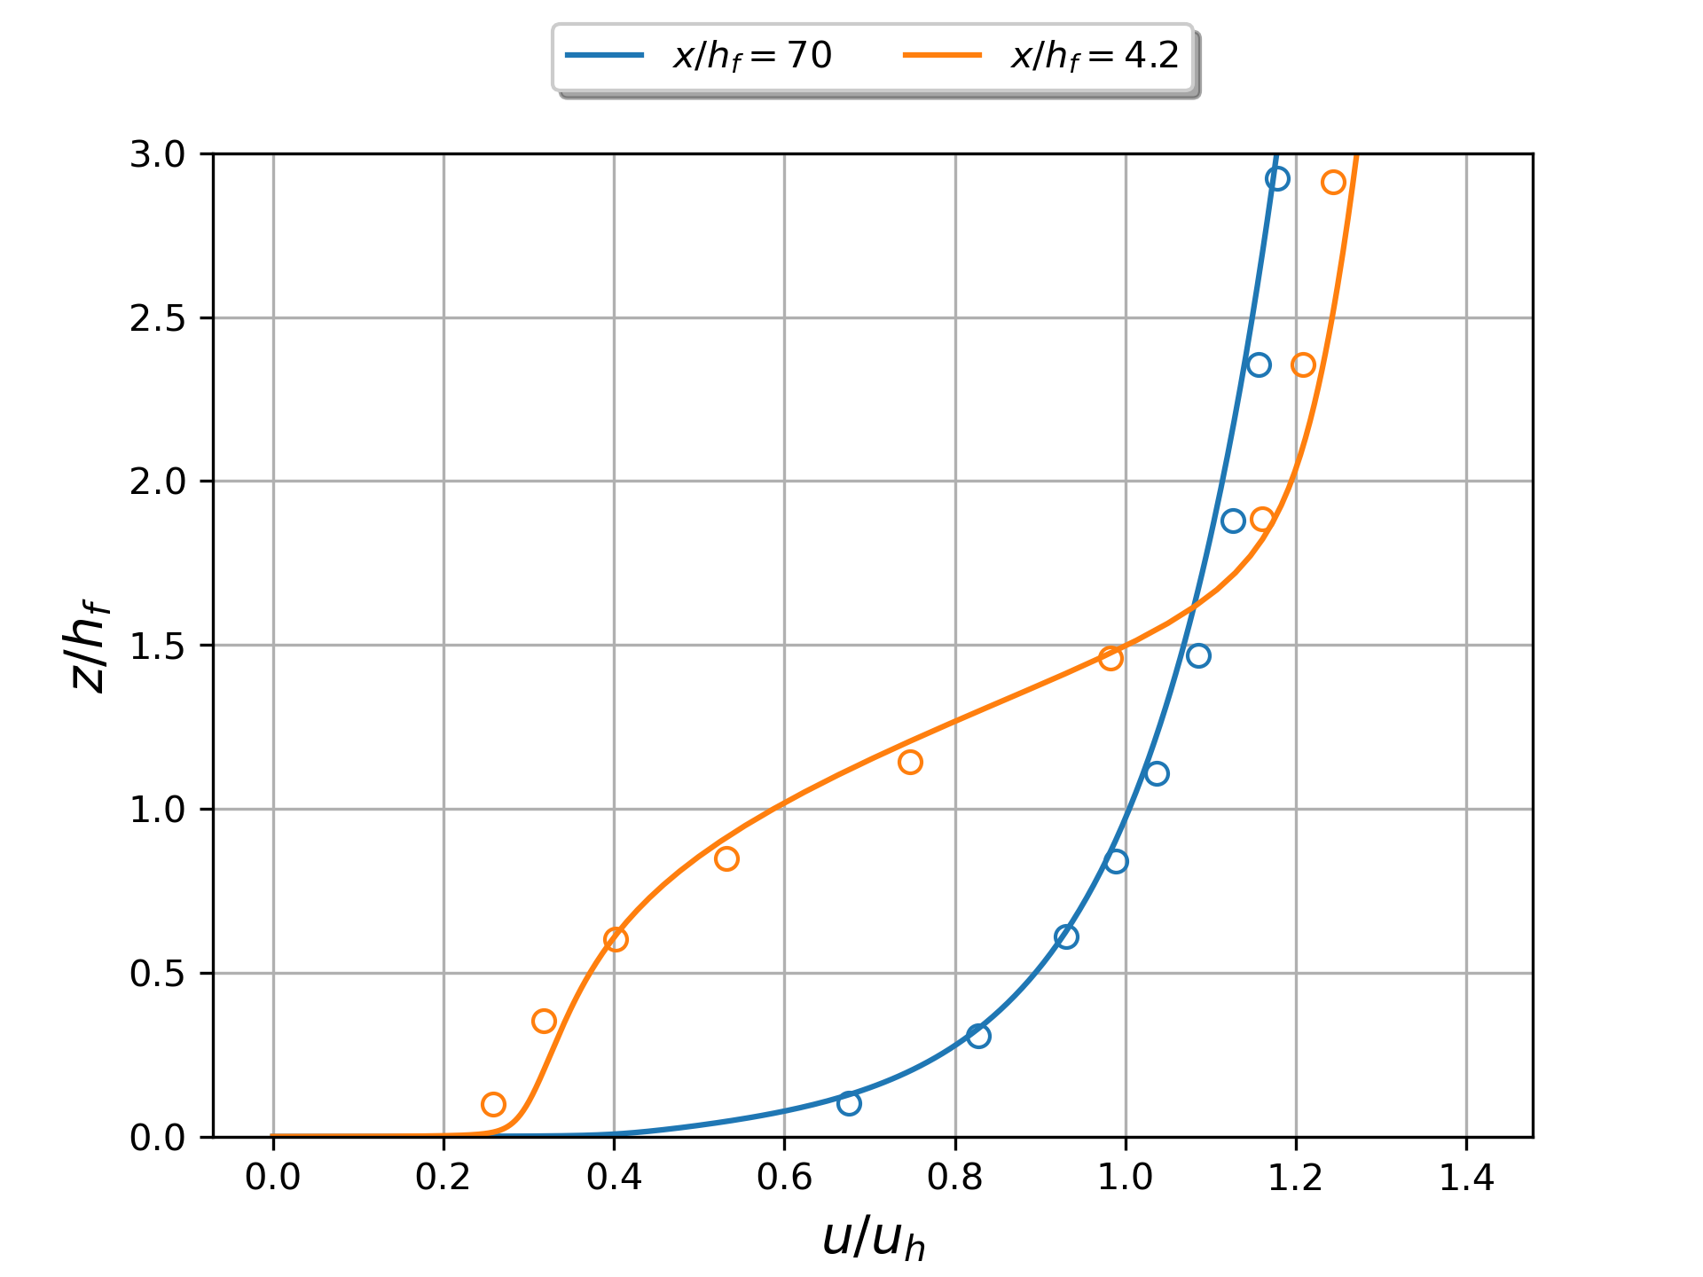
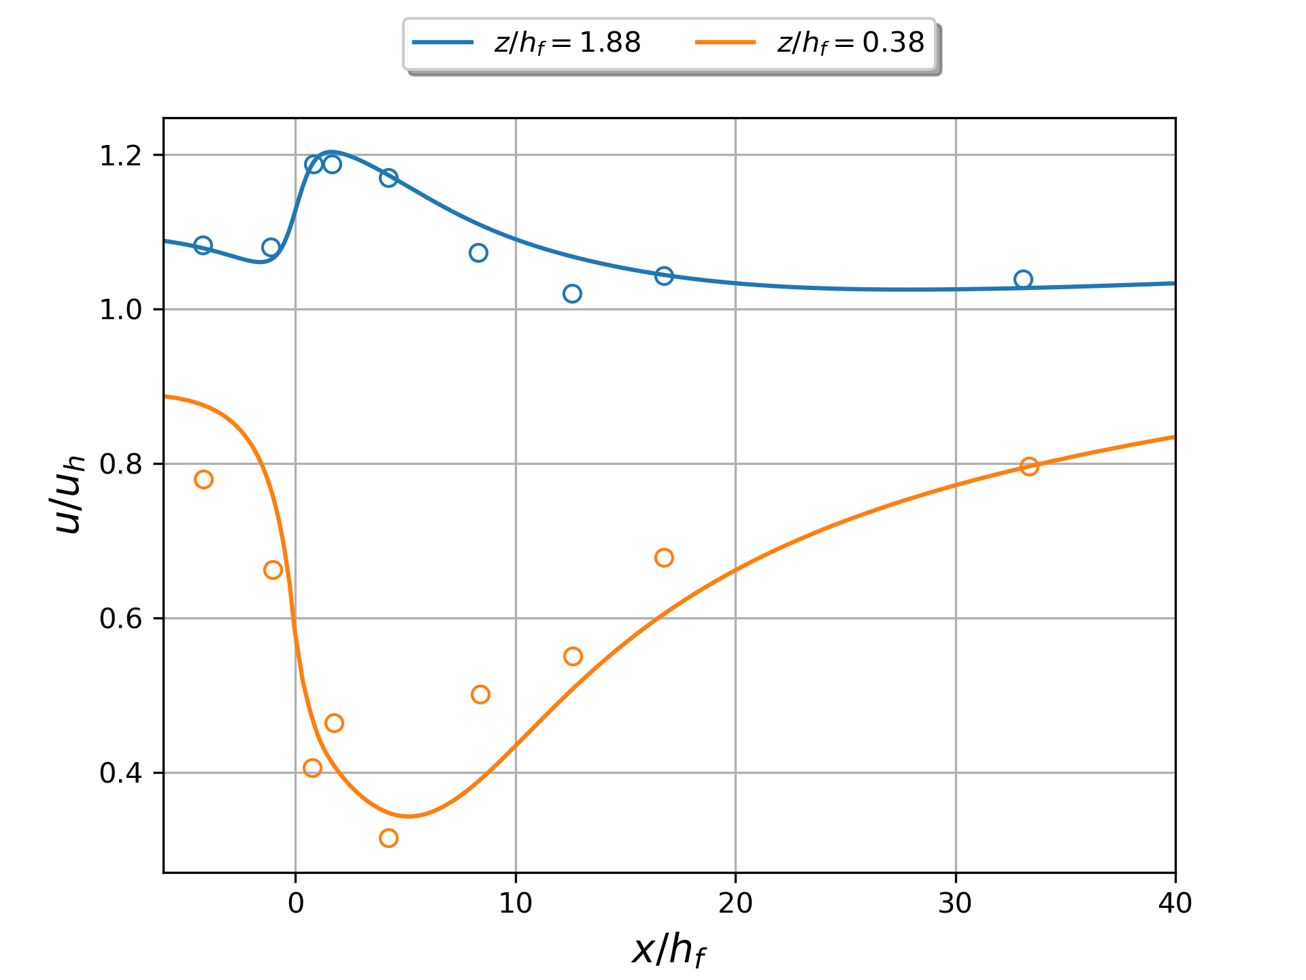
Bachelorarbeit

Slide 5
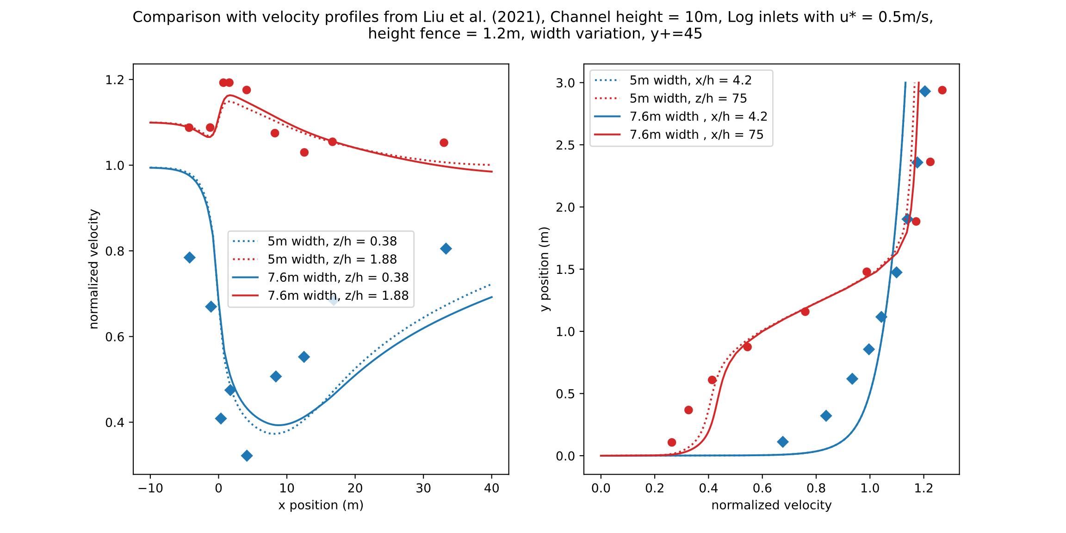

Slide 6
